Slide 1
SMART CAR
TEAM:- The Defenders(SC2)
Milin Parekh
Viraj hapaliya
Gaurang joshi
Smart city
Smart Driving Experience

Slide 2
Side mirror replaced by the cameras
We will now be able to get the processed output.
While changing lane in in speed on highway even the car coming from far point in speed matters. So this cameras will be able to detect that cars even , eliminating the threat.
Clear monochrome vision in night time .
Better quality then regular camera
Cheaper in cost.

Slide 3
Precautionary alert system
Forward collision alert by gradually applying slow brakes.
Sideways collision alert even airbag deployment on arriving of a speedy object.

Slide 4
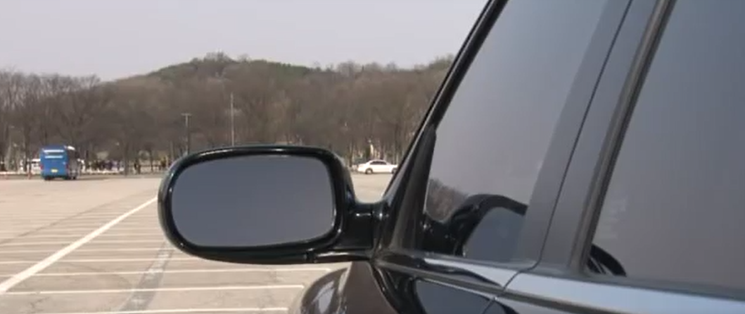
Mirrors before

Slide 5
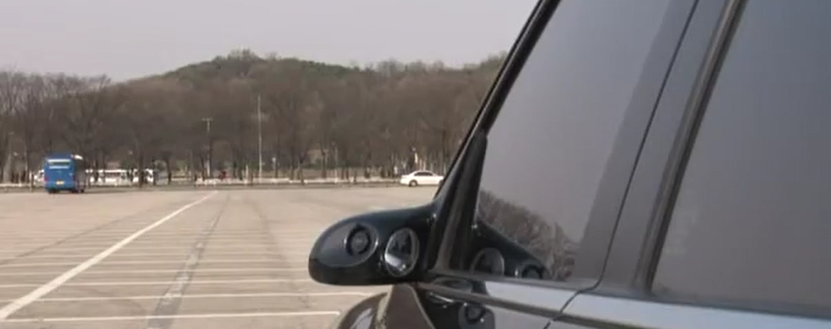
Mirrors Now

Slide 6
LANE
DETECTION

Slide 7
This software processed output of the simulatory system can be implemented to a hardware using raspberry pi board and a camera on it where the same code written in the laptop will run.

Slide 8
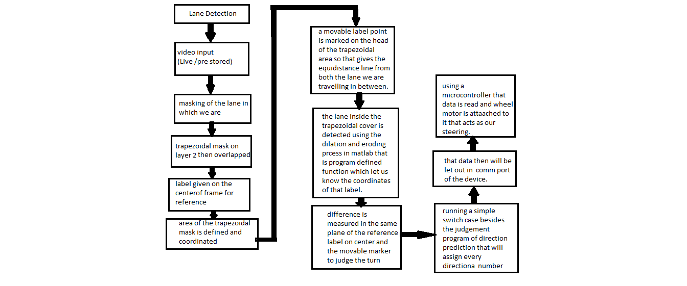

Slide 9
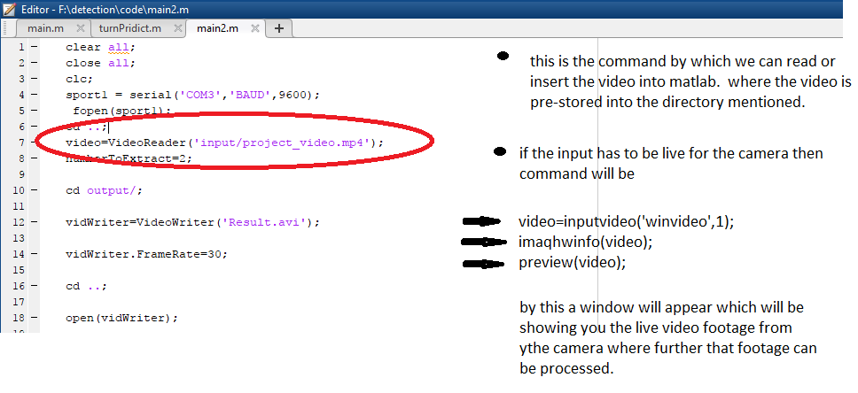
For detecting the Road & the lane we need a video input whether pre stored or live

Slide 10
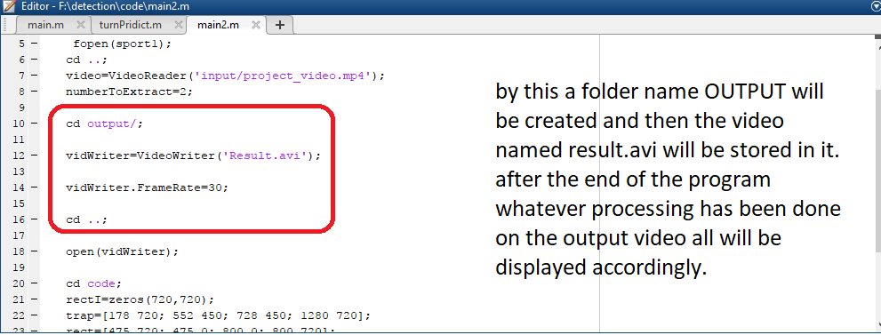
Video output path

Slide 11
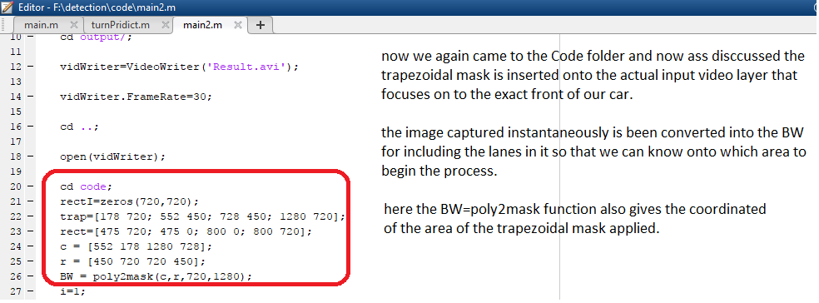
Trapezoidal mask to filter other lane ‘s footage.

Slide 12
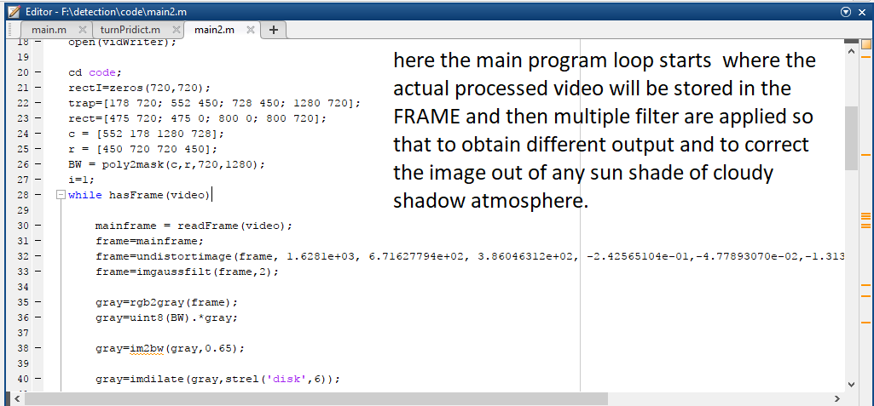

Slide 13
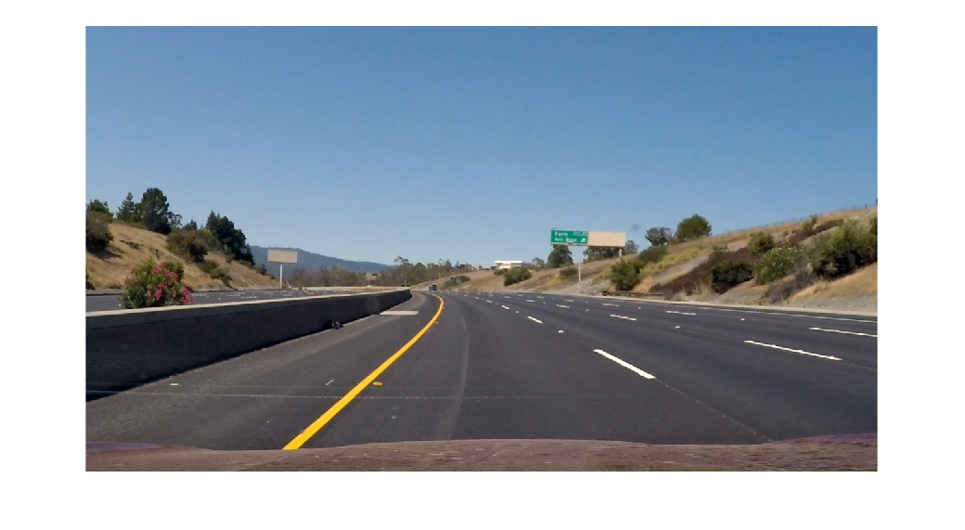
The original picture taken instantly from video.

Slide 14
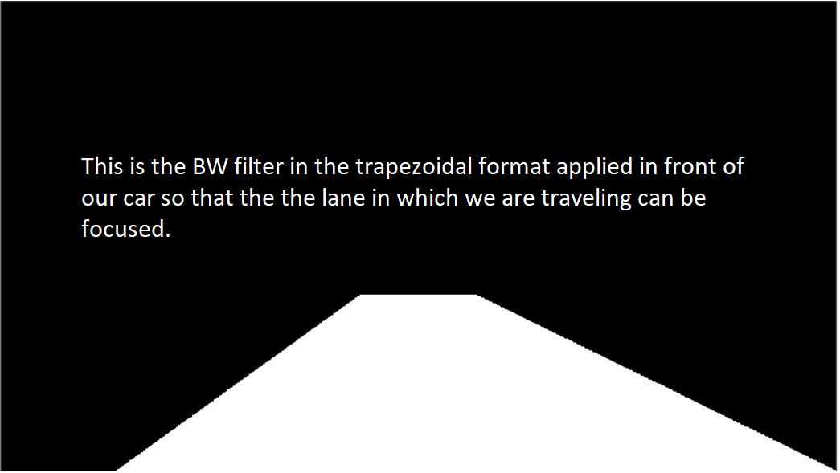

Slide 15
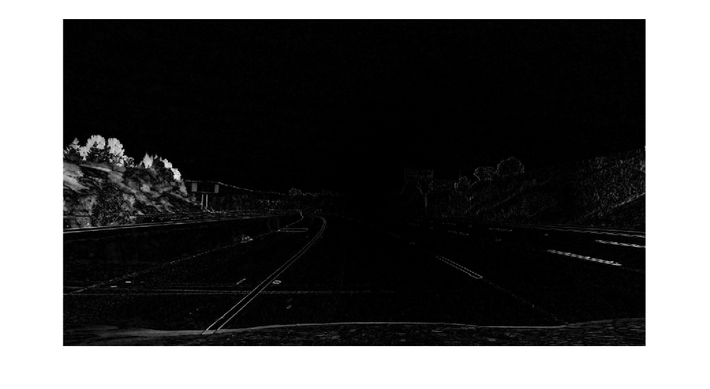
Again the undistortion filter is applied to filter out rest of the background so the focus can be on lane in which we are.

Slide 16
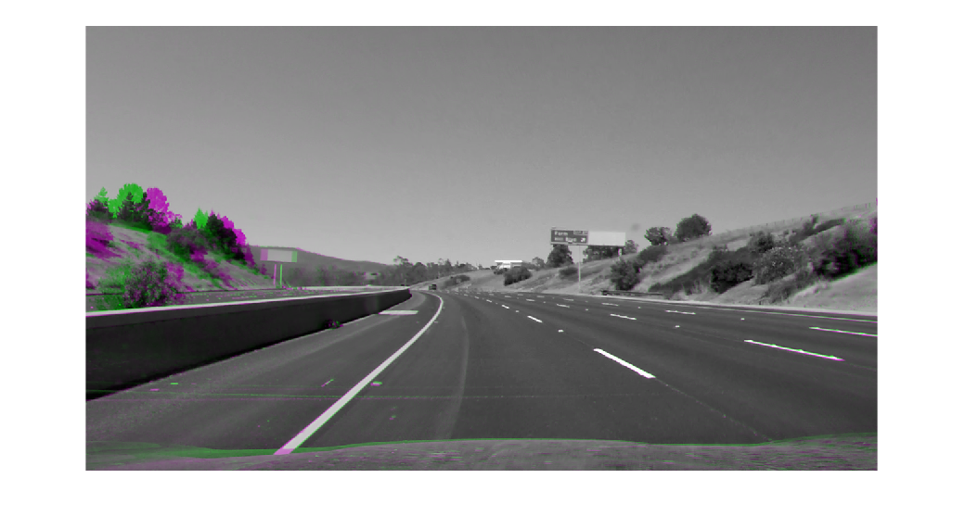
Gray conversion of original image as per mentioned In the code

Slide 17
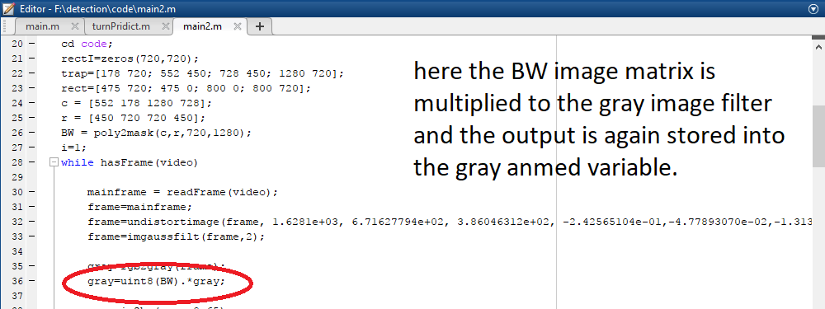

Slide 18
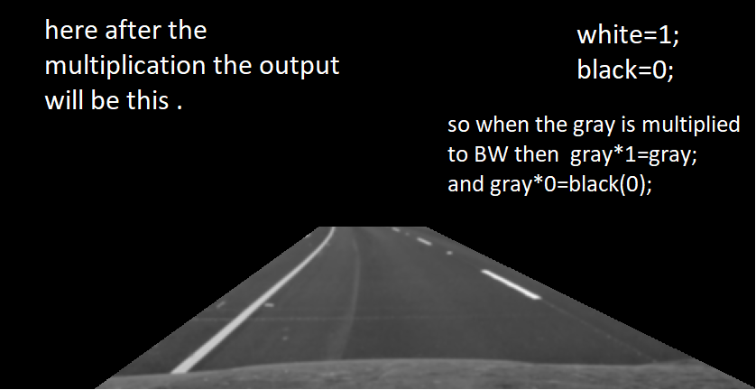

Slide 19
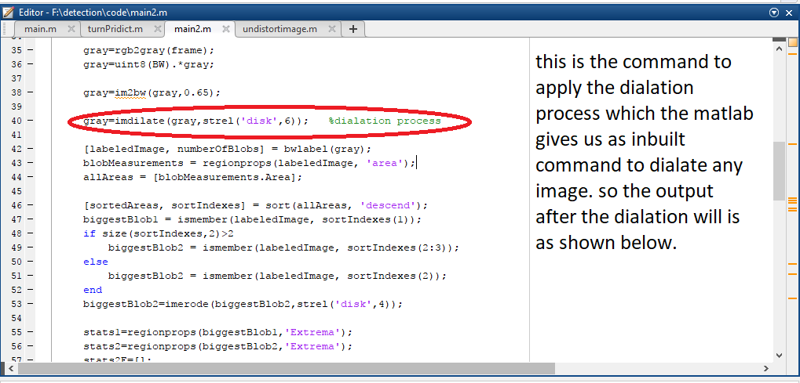
DIALATION PROCESS

Slide 20
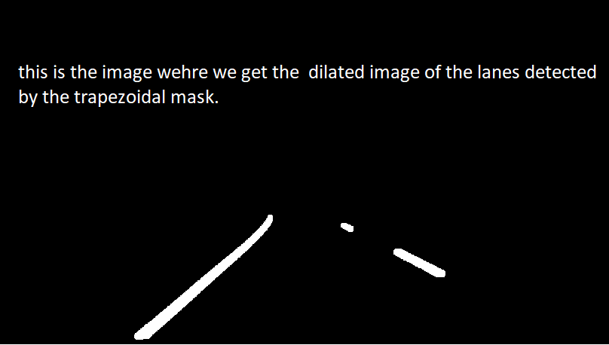

Slide 21
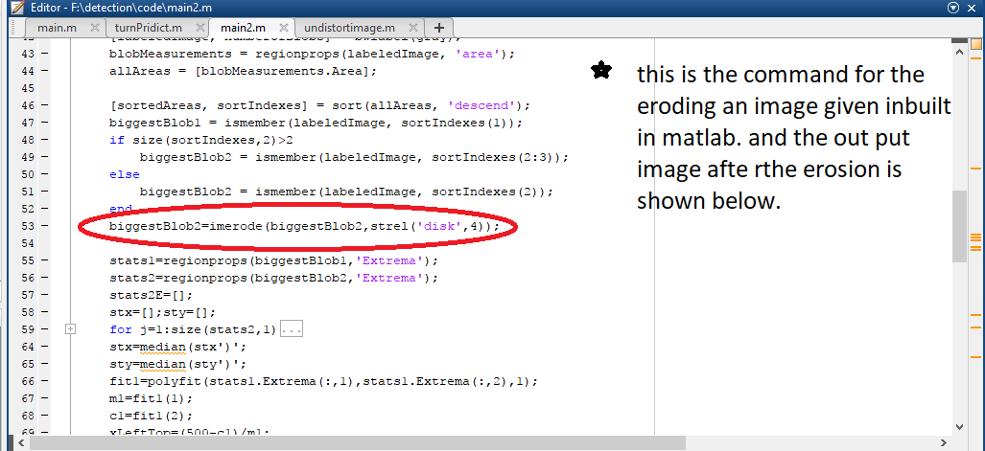
Erosion process

Slide 22
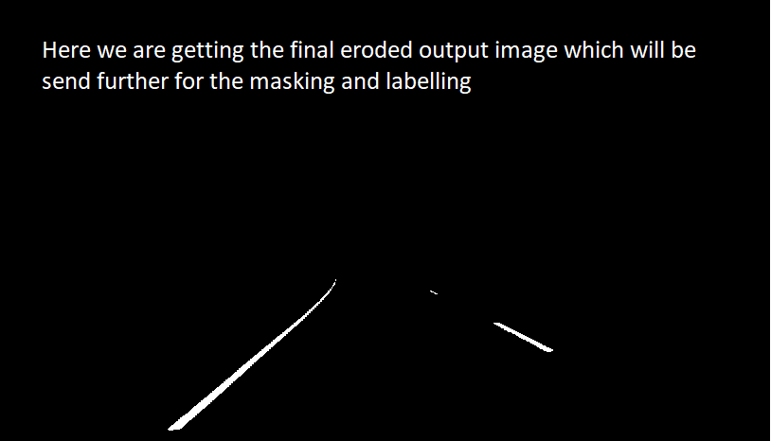

Slide 23
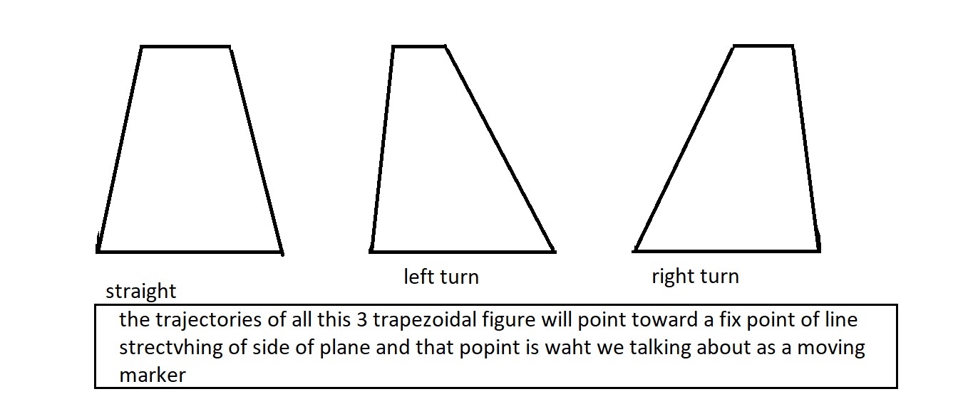

Slide 24
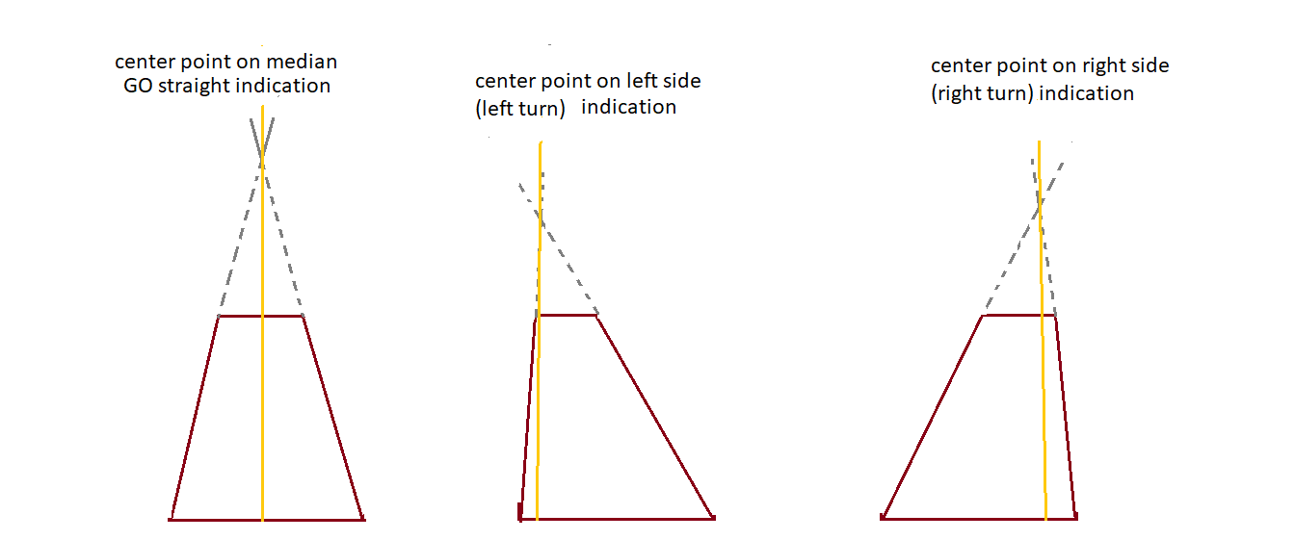

Slide 25
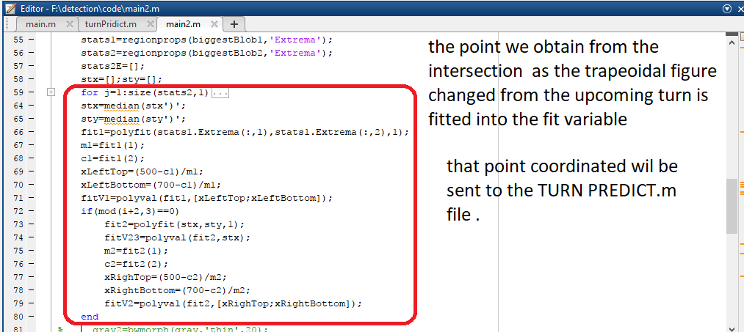

Slide 26
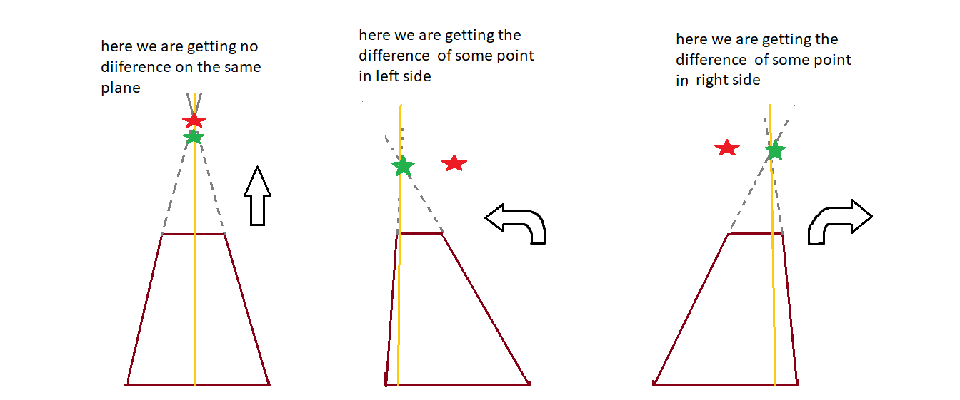
Judgement:-
Here the red marker is the reference marker right at the cente
Of the input frame ,kept there to compare the generated
marker to predict turns.

Slide 27
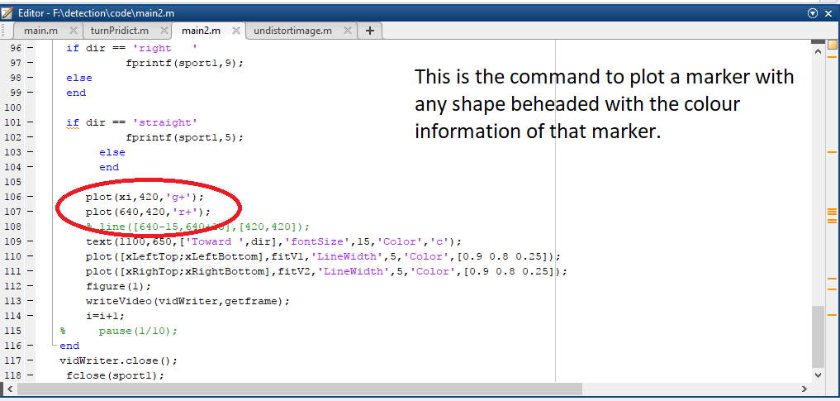

Slide 28
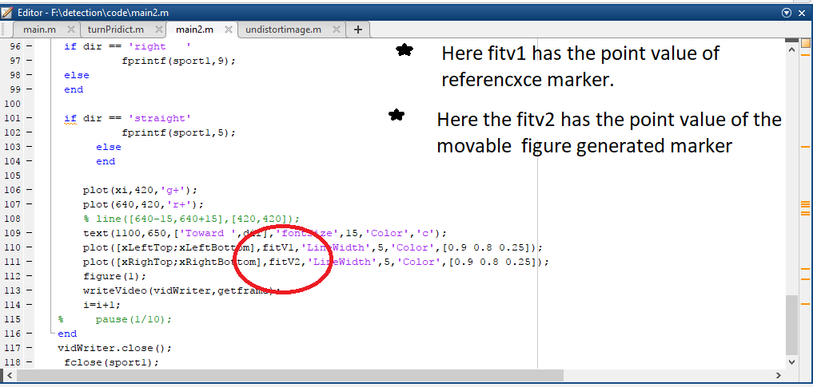

Slide 29
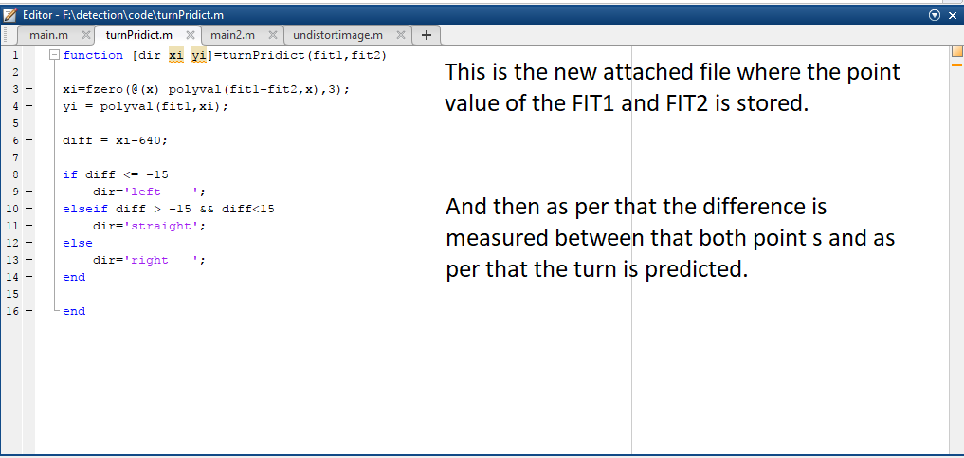

Slide 30
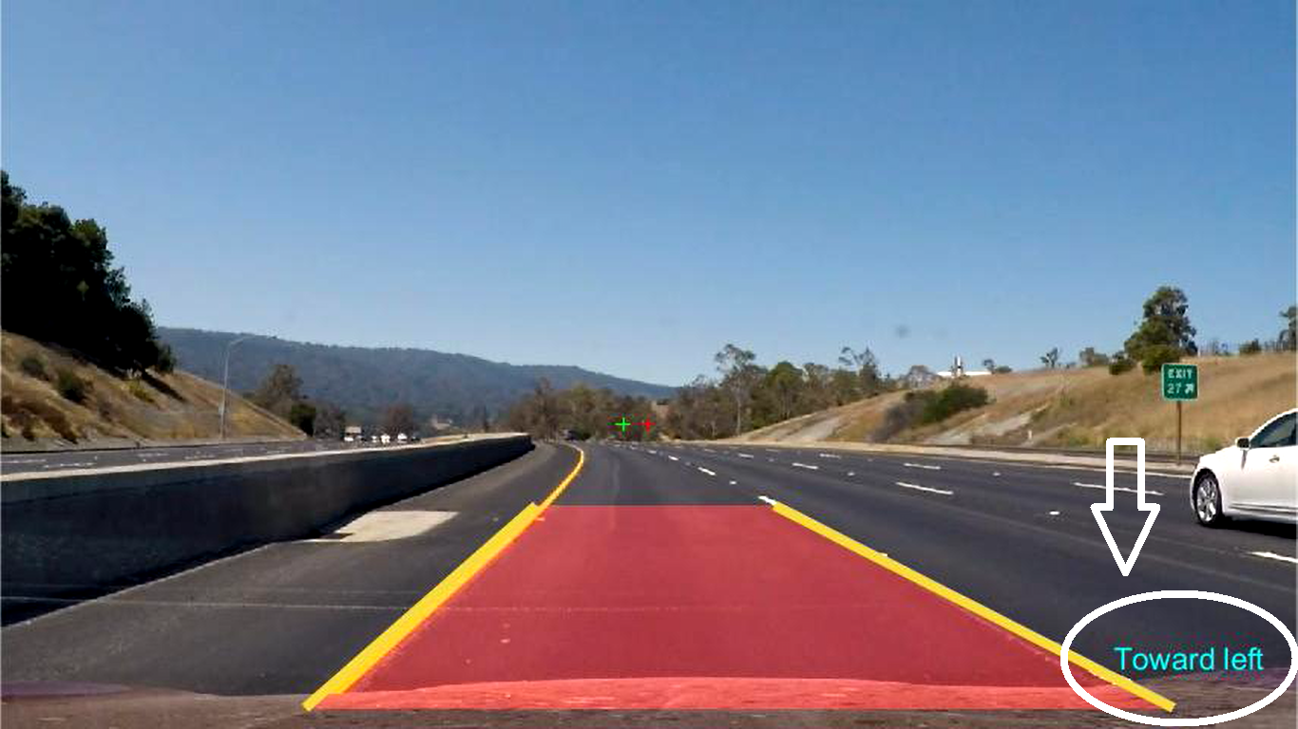
Actual display of turn prediction.

Slide 31
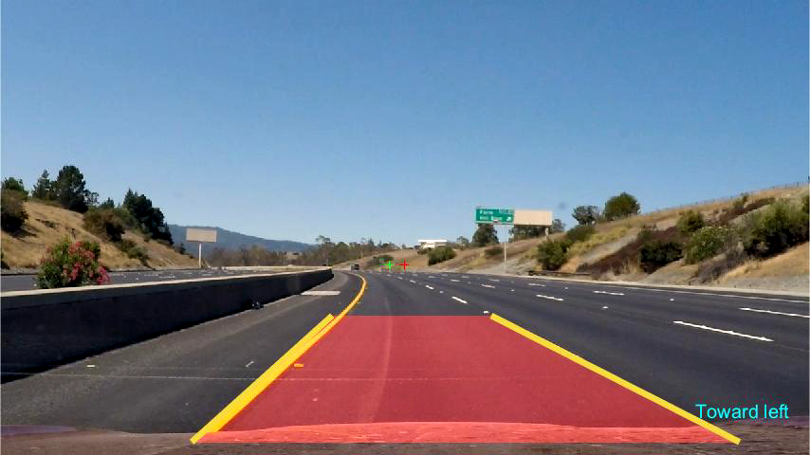

Slide 32
Tools & Technologies
Arduino board
Raspberry pi board
USB cameras’
MATLAB software (image/ video processing tool)
Ultrasonic sensors
Motor driver
Remote controlled robot car to depict the features

Slide 33
Challenges:-
He mapping of the road while changing the lane the predicted output may be confusional and we are working on it.
Moreover every where the road is not same, thus that is hard for the computer to judge.

Slide 34
Future Scope:-
Smart car/ driverless car/ self driving car, multiple names for a same desired result people want so here we have shown you all an easy way to deal with major break through /shown one more possibilities of developing a self driving car.
Further multiple advancements can be added into it like sign detection , unusual motion detection ,car detection, and can help make drive smooth and efficient ,and we all know what the future is about to emblaze us with.
In the same module which we used this all features can be added with no extra hardware addition.
Mainly you all know the google self driving car and electric car of tesla , by Elon musk.

Slide 35
THANK YOU

